Slide 1




The Importance of Cyber Insurance
Navigating Cyber Risk in the Digital Age
Presenter:
Chris Taylor
Senior Insurance Advisor
Chris.Taylor@thinkccig.com
(623) 268-9298

Slide 2
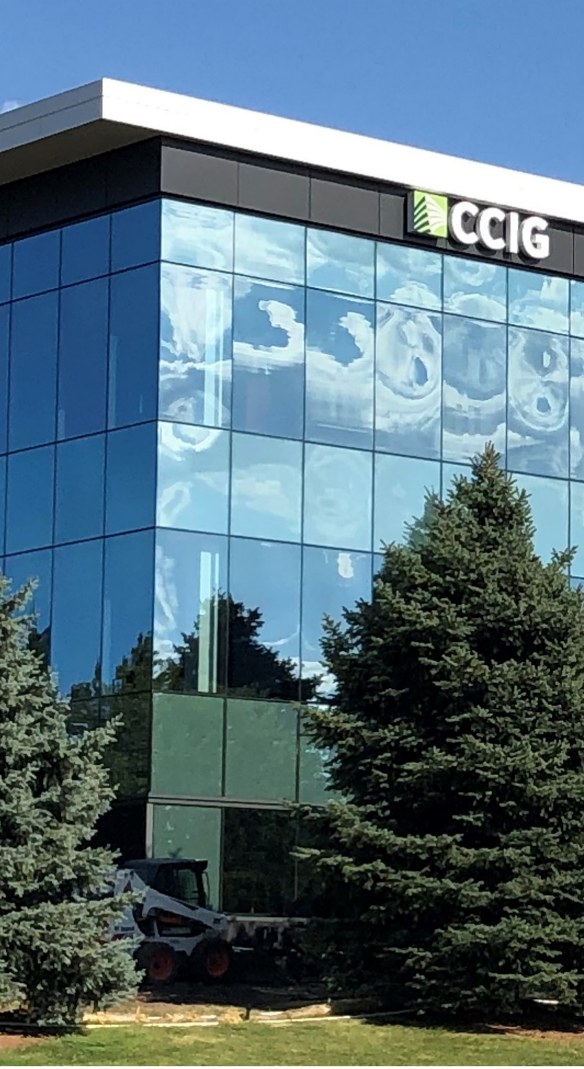
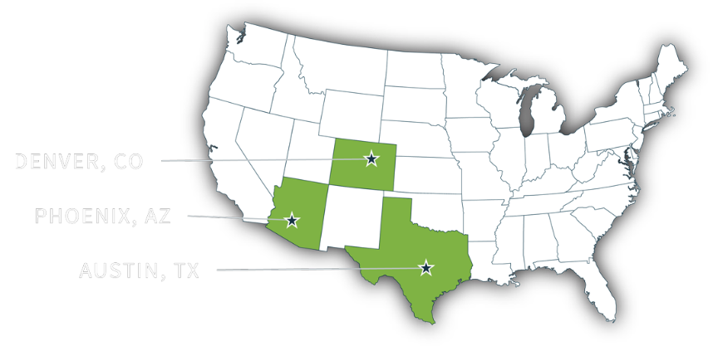
About CCIG
CCIG IS A FULL-SERVICE PRIVATE CLIENT, COMMERCIAL LINES, AND EMPLOYEE BENEFITS INSURANCE BROKERAGE.
Since 1985, CCIG has been a fiercely independent, rapidly growing insurance brokerage, delivering comprehensive risk management and insurance solutions to our diverse clientele. With a national presence, we employ over 100 seasoned insurance professionals and operate from our offices in Denver, CO, Austin, TX, and Pheonix, AZ.
PRIVATE CLIENT
PROPERTY & CASUALTY
EMPLOYEE BENEFITS
CCIG's Private Client Group consists of 17 insurance professionals. This group of high-caliber experts focuses exclusively on providing tailored, strategic risk management solutions for your lifestyle and financial milestones.
Family insurance program review, analysis, and recommendation summary.
Proactive renewal touchpoints at 60 days and 30 days before renewal.
CCIG provides the most comprehensive advice and tools needed to control costs and structure plans that meet the business’s strategic long-term goals.
We provide Program design and deductible optimization claims advocacy, claims reporting and trends, coverage review, and negotiation.
As well as safety Consulting, SAFE assessment, staff training, OSHA compliance, and cost containment programs.
We inspire our clients to think about healthcare in a new way, empowering them to take control of their future.
Our comprehensive approach includes care coordination, third-party administration, tailored stop-loss coverage, prescription benefits management (PBM), and cost-containment strategies.
With data we collect through our partners and actuaries, we paint a picture of both the present and the future to drive the direction of changes to the benefit program.
© CCIG All Rights Reserved
2

Slide 3

Agenda
What is Cyber Insurance?
Cyber Exposures Explained
Current State of the Market
Top 2 Claims
Emerging Issues & Developing Litigation
Q&A

Slide 4
What is Cyber Insurance?
Insurance designed for the digital age
Protects your tangible assets
Ransomware
Scams
Supply Chain
Data Breach

Slide 5
What Cyber Insurance Covers
FIRST-PARTY COVERAGES
01
Breach Response Costs
Breach Coach, IT Forensics, Legal, Notification, Call Center Services, Credit/Identity Monitoring, and Public Relations
02
Data Restoration
Covers the cost to restore or repair data lost during a cyber event.
03
Business Interruption
Covers loss of income because of business interruption due to a cyber event on the Insured’s network.
04
Contingent Business Interruption
Covers loss of income because of business interruption on a third-party’s network.

Slide 6
What Cyber Insurance Covers
FIRST-PARTY COVERAGES CONTINUED
05
Cyber-Crime
Social Engineering, Funds Transfer Fraud, Computer Fraud, Invoice Manipulation, Cryptojacking, Telephone Fraud, and more.
06
Cyber Extortion
Covers the cost of ransomware response & ransom demand payment
07
Reputational Harm
Covers loss of revenue because of a cyber event damaging your reputation.
08
Bricking
Covers the cost to replace hardware rendered unusable because of a cyber event.

Slide 7
What Cyber Insurance Covers
THIRD-PARTY COVERAGES
01
Network Security Liability
Covers defense costs and damages for which you are held liable for failure to protect your network.
02
Privacy Liability
Covers defense costs and damages for which you are held liable for disclosure or failing to protect protected sensitive information.
03
Regulatory Fines & Penalties
Covers defense costs an damages for violations of applicable state, federal, or international data protection laws.
04
PCI DSS Liability
Covers defense costs to respond to a PCI inquiry and covers fines, penalties and assessments charged by banks for non-compliance with PCI-DSS

Slide 8
Common Cyber Misconceptions
“I don’t collect sensitive data.”
“We invest in cybersecurity, so we’re protected.”
“Cyber insurance is too expensive.”
“We’re too small to be targeted.”

Slide 9
Current State of the Cyber Market
$16.8B
$377K
82.1%
Losses due to cyber attacks in 2024.
Coveware’s average Ransom payment in Q3 of 2025.
The percent of attacks on companies with less than 1,000 employees
(33% increase YoY)
(166% from Q2 2025)
*Source: Coveware Quarterly Report 10/24/25 FBI Internent Crime Report 2024

Slide 10

Top Claims
© CCIG All Rights Reserved
10

Slide 11
Ransomware
Ransomware Attack Vectors
Remote Access Compromise (RDP)
Phishing/Social Engineering
Software Vulnerability
Internal
*Source: Coveware Quarterly Report 10/24/25

Slide 12
Ransomware
RANSOMWARE IMPACTED COMPANIES BY SIZE
(Employee Count)
1 to 10 – 3.9%
11 to 100 – 31.1%
101 to 1,000 – 37.9%
*Source: Coveware Quarterly Report 10/24/25

Slide 13
Supply Chain Attacks
Targets
Technology Supply Chain Partners
MSPs
Examples
Kaseya
SolarWinds
CDK Global
MOVEit
*Source: Coveware Quarterly Report 10/24/25

Slide 14
Social Engineering
Sending money to the wrong place
  Aka Funds Transfer Fraud, Wire Transfer Fraud, and Computer Fraud
  Employee’s, C-Suite, Clients, Vendors, etc.
#1 Cause = Human Error
*Source: Coveware Quarterly Report 10/24/25

Slide 15
Emerging Issues & Developing Litigation
Biometric Claims
More companies are using fingerprints, facial scans and other forms of biometric data to identify customer and employees. According to Legal Dive, these techniques have triggered an increase in lawsuits using the Illinois Biometric Information Privacy Act (BIPA)
Artificial Intelligence (AI)
AI is transforming businesses – automating tasks, powering analytics, and reshaping customer interactions. What many believe to be the way of the future, AI is a double-edged sword. While some adopt AI for protection, attackers are using it to scale and intensify cybercrime.
Pixel Tracking Claims
Many organizations use pixel tracking to track behavior and target ads, though this practice has come under fire. Multiple class action lawsuits have involved the use of Meta’s tracking pixel, often claiming that the practice amounted to unlawful collection of data. Some data shared with Meta may represent a HIPAA violation.

Slide 16
In Summary
All businesses have an exposure
  Cyber claims and frequency are still on the rise
    $16.6B in cyber losses in 2024 (+33% YoY)
    $377k average Ransom Payment in Q3 2025 (-21% YoY)
  Small businesses make up over 98% of all cyber incidents, yet the proportion of payouts is even between large companies and SME’s.
  Supply chain exposures pose huge threat to businesses with a reliance on 3rd party technology partners.
*Source: Coveware Quarterly Report 10/24/25

